Slide 1
The switch statement
By: M Usama
Code with MU

Slide 2
Definition
The switch statement lets the value of a variable or expression determine where the program will branch.
It is same like an if-else statement but there is a little bit difference of there syntax and expression.
Code with MU

Slide 3
syntax
int
Key word
char
switch ( IntegerExpression)
{
case ConstantExpression:
// place one or more statements here
case ConstantExpression:
// place one or more statements here case statements may be repeated as many times as necessary
default:
//place one or more statements here
}
User choice
Code with MU

Slide 4
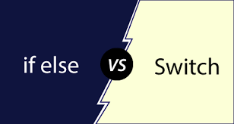
If else vs switch
Code with MU

Slide 5
Difference between if-else and switch
There id two major difference between switch and if else.
1.syntax
2.data type of expression
We will see in code
If-else
switch
int
char
float
double
pointers
int
char

